Slide 1
The Crime Detectives
Natasha
Jiffar
Kobe
Thierno

Slide 2
NYPD arrest data Analysis 2019
New York City has been ranked #25 with the most violent crimes rates in the United States. Since we all reside in New York, and safety should be an important aspect of our livelihood, we have embarked on the quest to find out where, who, why, when and what by investigation via Exploratory data analysis and machine learning techiques to make further predictions on which level of arrest is likely to occur based on any number of factors.

Slide 3
The NYPD arrested 210,000 persons in 2019
The following information is recorded with each arrest:
Type of Crime, Borough of Crime, Arresting Precinct , Age, Gender, and Race of the arrested
If the race of the person was no longer available to us, could we predict it using a model trained on past data?
Our result: (0.56 precision) (0.85 recall) (0.69 F1 score) for Black

Slide 4
Principal features for analysis
Level of Offense
Offense description
Borough of arrest
Precinct where the arrest occurred
Perpetrator’s age within a category
Perpetrator’s sex description
Perpetrators' race description
Date of the arrest

Slide 6
We created the following classification models and trained and validated them:
Logistic Regression(Label Encoded and One-Hot Encoded;with and without PCA)
KNeighbours Classifier
Support Vector Machine
Decision Tree
Random Forest
Random Forest for Feature Importance then Random Forest

Slide 7
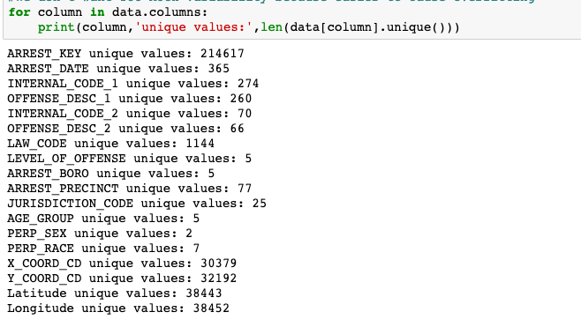
Within Column Variability (unique values)

Slide 8
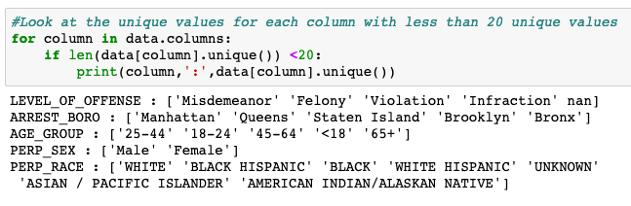
Within Column Variability (unique values) cont…

Slide 9
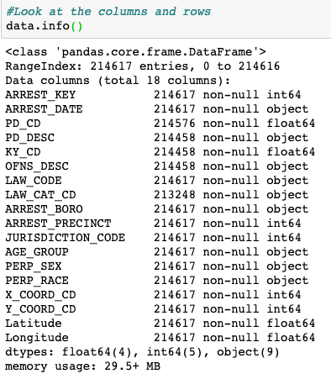
Even though we have numerical values in our dataset, our classification models will not use them as numbers, but rather will use them as categories because the numbers do not represent a measurement: they are simply IDs for internal office use.

Slide 10
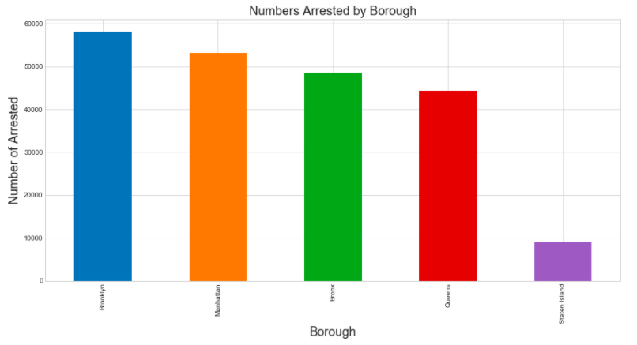
Arrests are spread out across the four Borough…

Slide 11
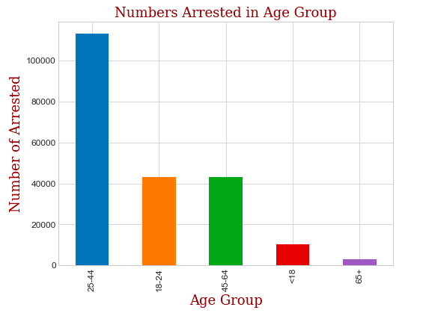
Persons between ages 25 – 44 make up a majority of arrested

Slide 12
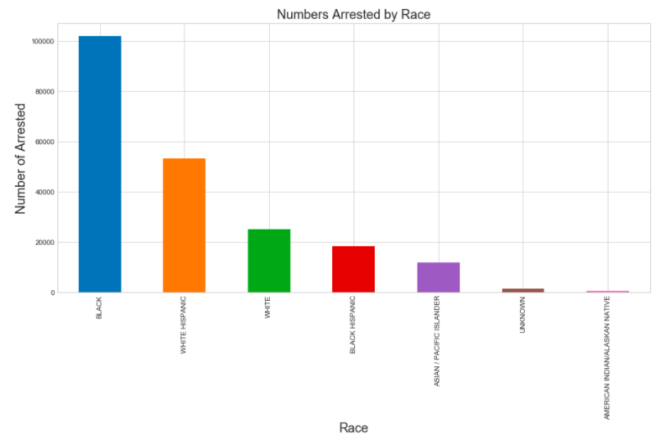
Persons who are black are more likely to be arrested

Slide 13
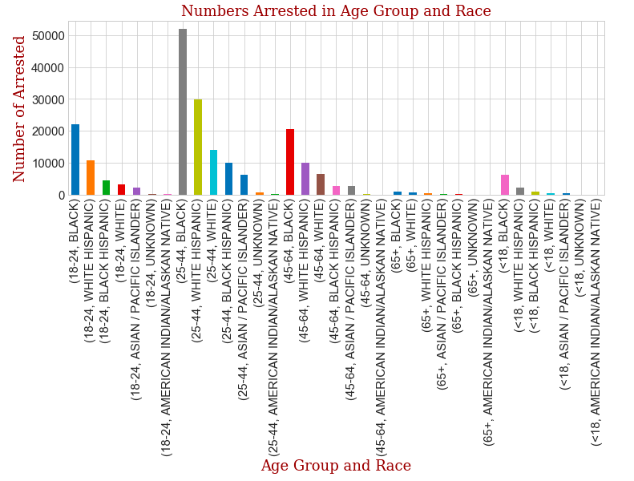
Persons who are black between 25-44 lead in the number of those arrested

Slide 14
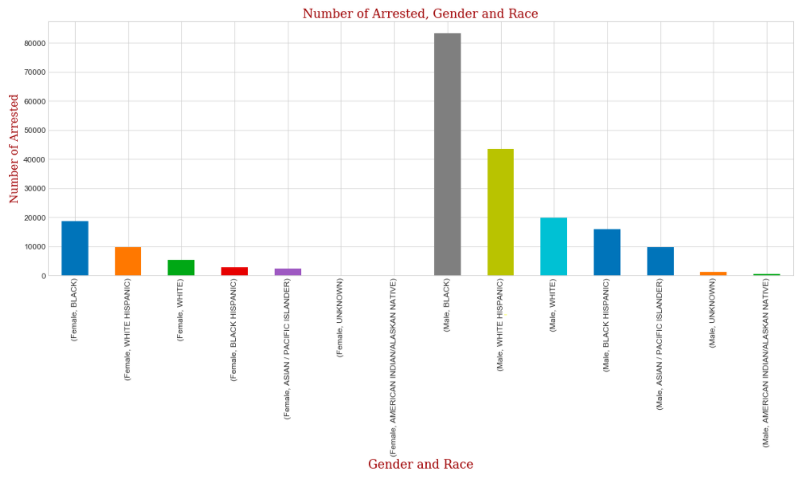
Males are arrested much more than females. Black males are arrested the most.

Slide 15
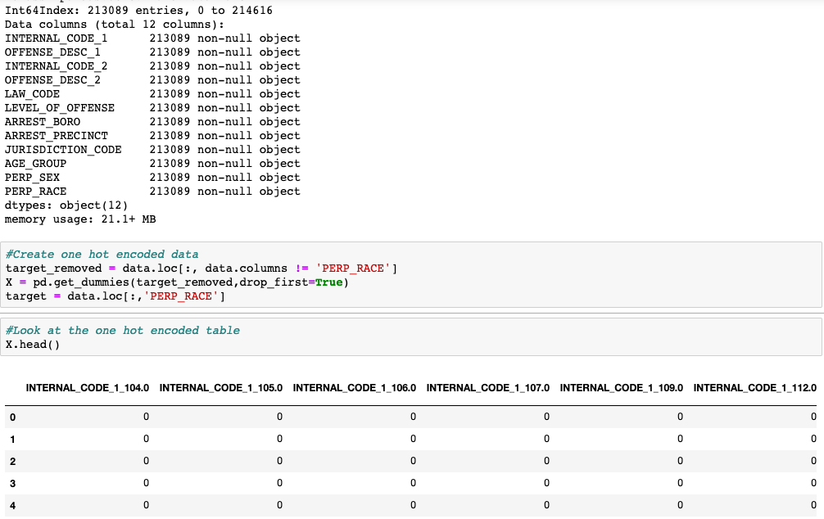
One Hot Encoding: Because the numeric columns contain internal NYPD codes and are not measurements, for our model every column is treated as nominal categorical for our classification (i.e: there is no ordering to the values)

Slide 16
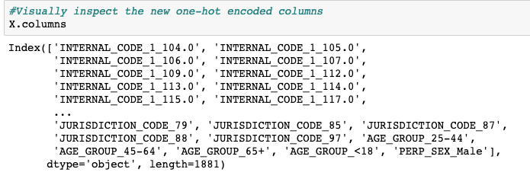
There is now 1,881 columns.
The one-hot-encoded dataframe columns

Slide 17
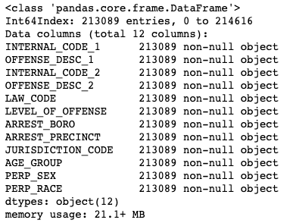
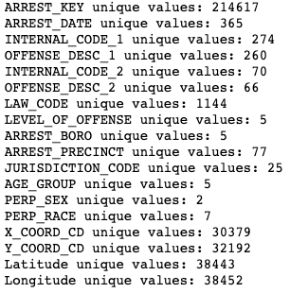
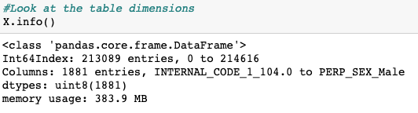
The cost of one hot encoding

Slide 18
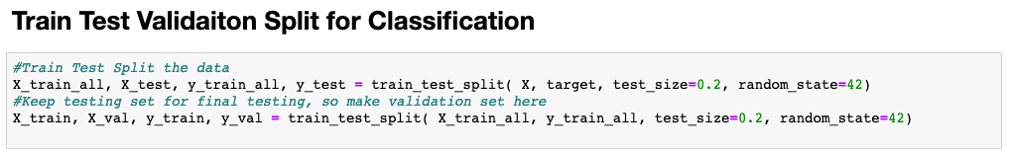
We used a validation and test split.

Slide 19
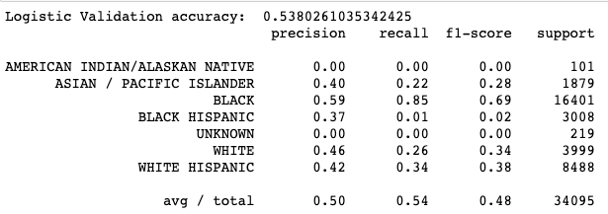
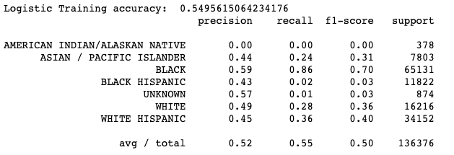
Logistic Regression without PCA

Slide 20
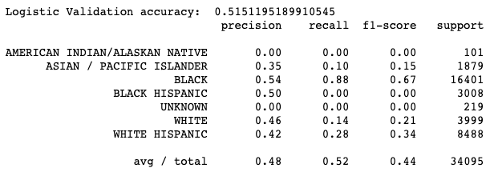
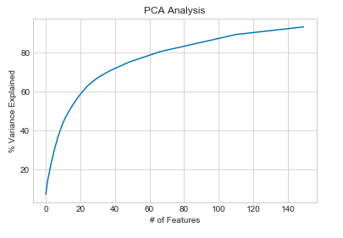
Logistic Regression with PCA

Slide 21
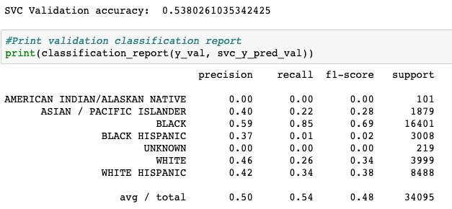
Support Vector Machine without PCA

Slide 22
KNeighbours
Took too long to train. Seems too many dimensions. Aborted

Slide 23
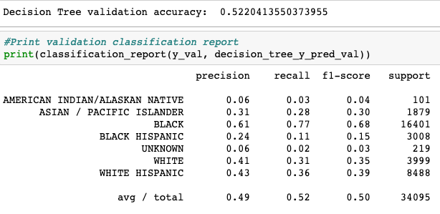
Decision Tree

Slide 24
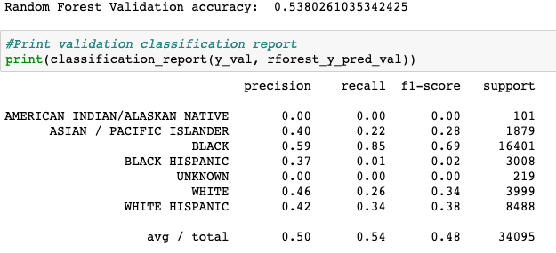
Random Forest

Slide 25
